Slide 1
Driver Onboarding Service By: Jitesh Meghwal
Craft Demonstration

Slide 2
About Me
CSE graduate (2021) from MNIT, Jaipur
Working as SDE at Walmart Global Tech, India, with their supply chain team responsible to maintain Walmart’s inhouse warehouse management system.
Working experience of 2+ years in Java, Spring Boot, Microservices.

Slide 3
Driver Onboarding Service Features
Register an existing user as a driver, capturing all the necessary details to create a driver profile.
Collect necessary documents for verification
Allow verification of uploaded documents from backend.
Once profile is verified, create shipments of tracking device by integrating with a third party module.
Once onboarding process is complete, giving user the option to mark itself as available to drive.

Slide 4
Assumptions
A user can onboard with a single vehicle only.
Driver onboarding process, driving document list & vehicle regulation rules are same throughout the country.
User personal details and credentials are stored and managed by another internal module responsible for authentication and authorization.
Background verification process include verification of uploaded documents.
Orders of tracking device are created and managed by another module, onboarding svc only integrates with the third party module to initiate the order and track the order status.
Once a shipment of tracking device is created, it is assumed, it will be delivered successfully. Logistics failure scenario are not handled.

Slide 5
Tech Stacks Used
Java
Spring Boot
SQL Server
Apache Kafka
Azure blob storage (Azurite to emulate)

Slide 6
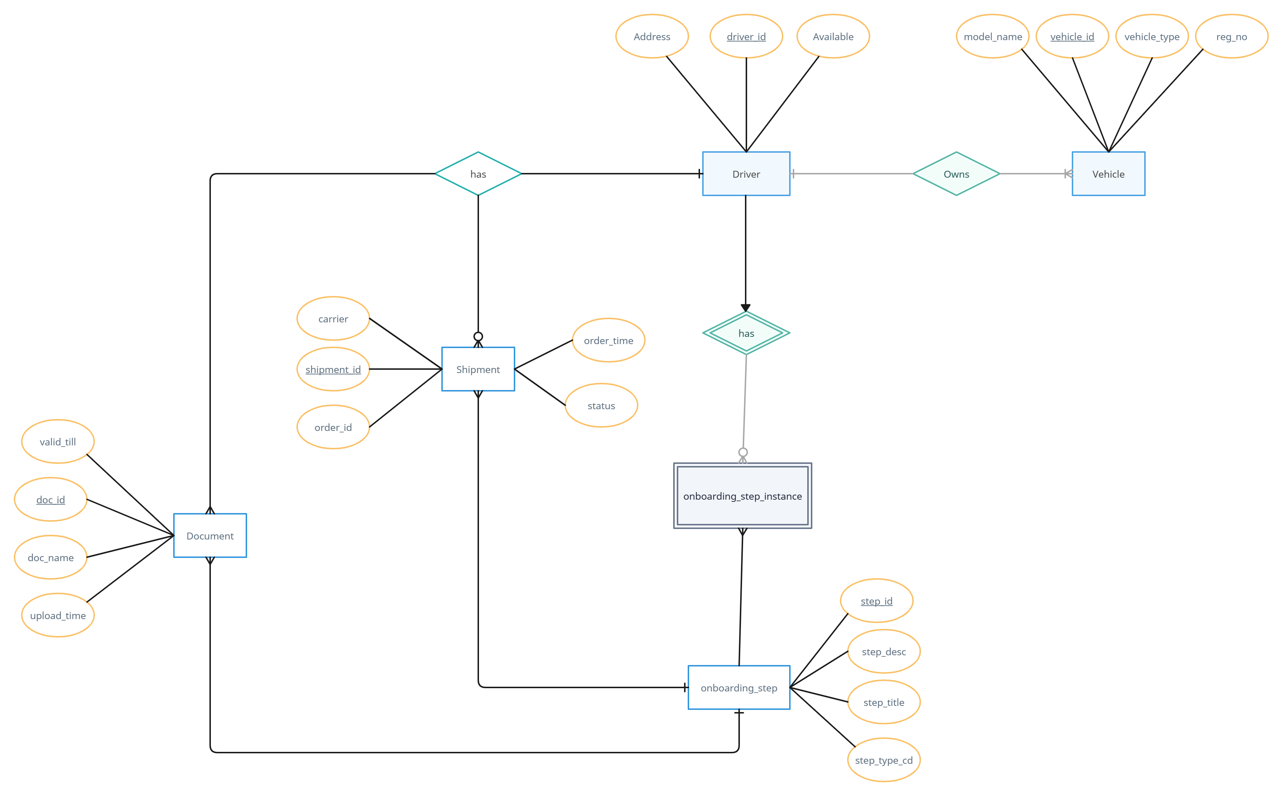
ER diagram

Slide 7
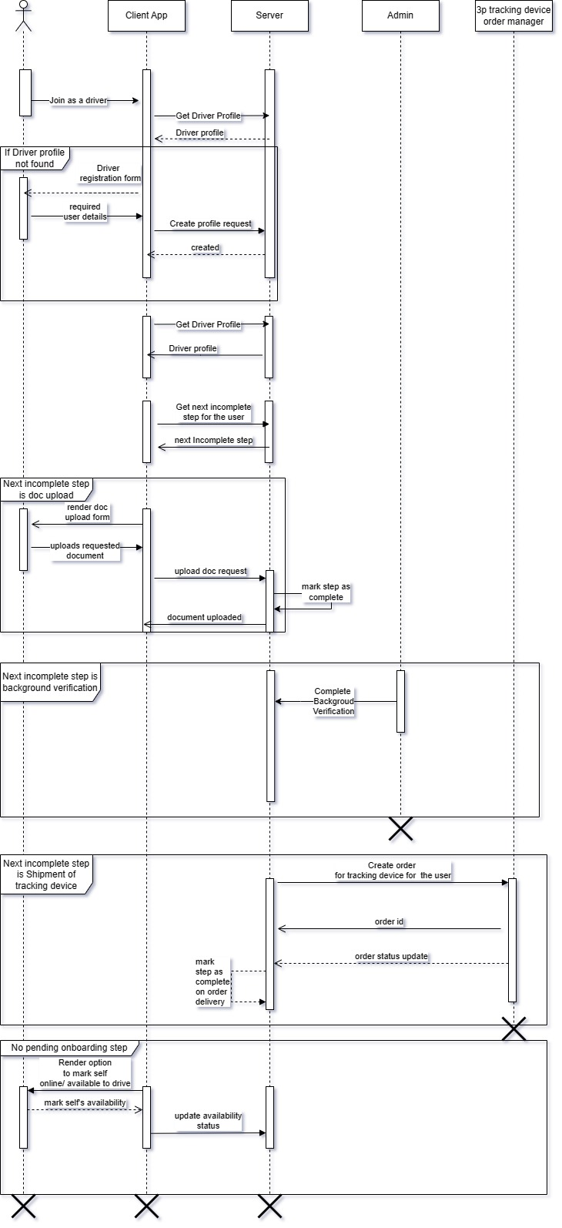
Sequence Diagram

Slide 8
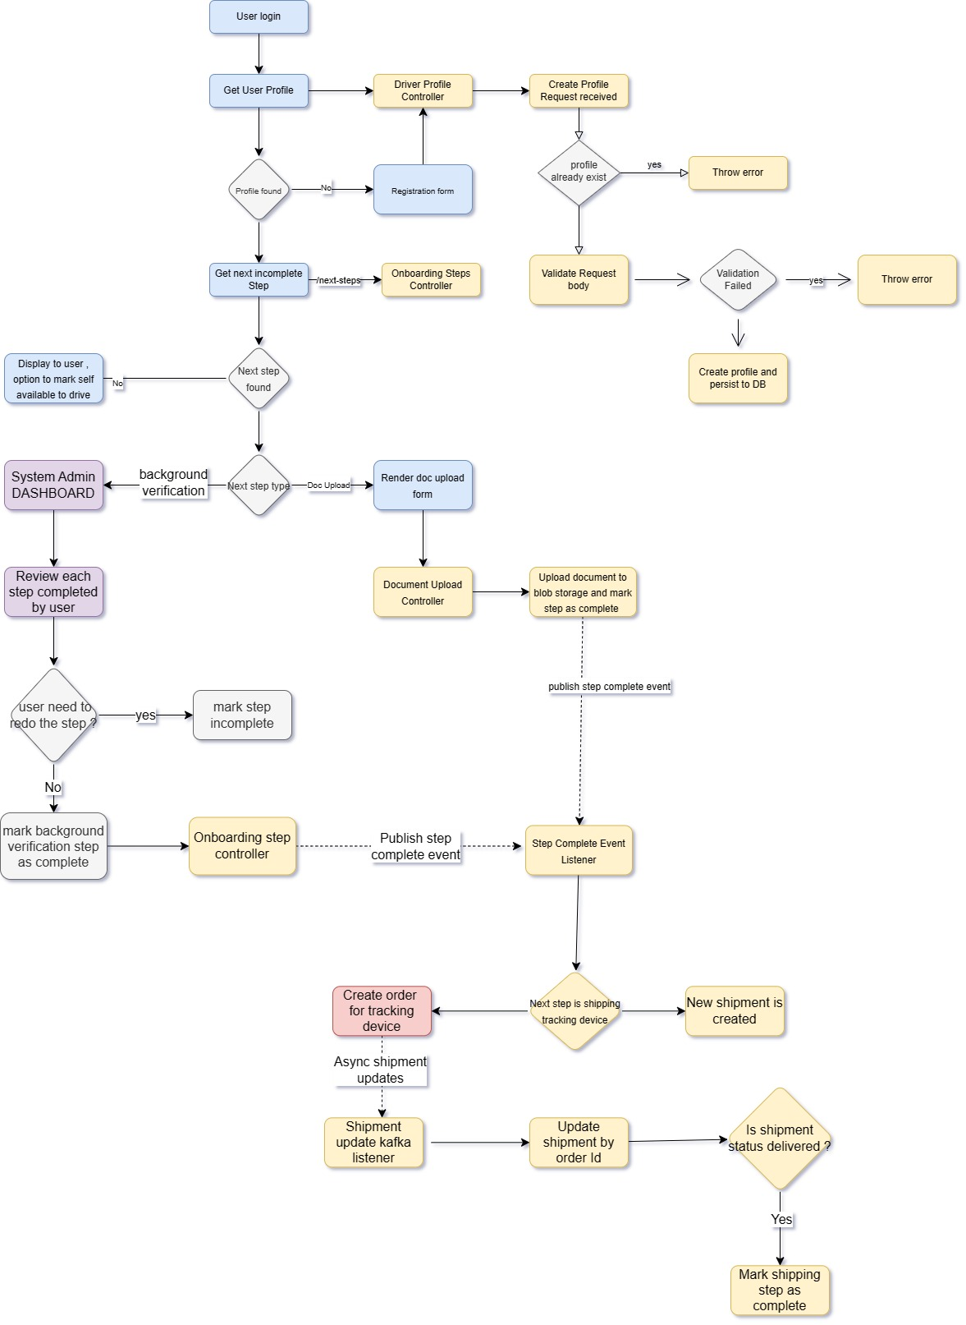
Flow chart

Slide 9
API Exposed
POST /driver-profile -> To register driver profile
GET /driver-profile -> To retrieve driver profile
GET /onboarding-steps/next-steps -> retrieve next steps for the user
PUT /onboarding-steps -> (Restricted to admin user), to mark onboarding step as complete/ incomplete for a particular user.
POST /document -> upload document
GET /document -> retrieve document
DELETE /document -> remove document
GET /shipment -> retrieve tracking device shipment details for user

